Slide 1
Healthy Housing in the Chicagoland Area:
Where Do We Rank Nationally?
Where Are We Headed?
What Are Our Challenges?
What Works?
Dave Jacobs, PhD, CIH,
University of Illinois at Chicago
National Center for Healthy Housing

Slide 2
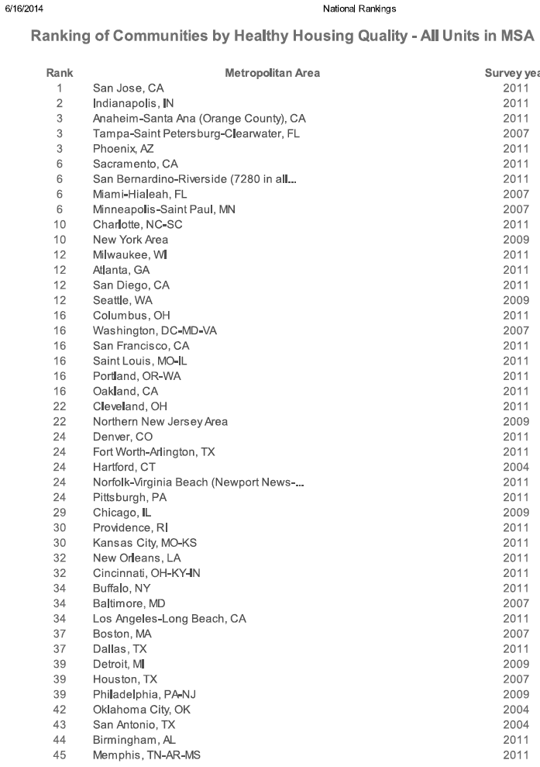
National State of The Nation’s Healthy Housing:
Chicagoland Area Ranks 29th
Prior Ranking: 11th (Out of 45 large urban areas)

Slide 3
The Good News: Chicagoland area had fewer homes with:
Signs of rats
Siding problems
Room heaters without a flue
Incomplete plumbing
Exposed wiring
Fewer water leaks from inside

Slide 4
The Bad News
More homes with:
Water leaks from outside
Heating and plumbing equipment breakdown
Inadequate kitchen facilities
Problems with broken plaster or peeling paint
Sewage disposal problems
Foundation problems

Slide 5

Florence Nightingale
“The connection between health and the dwelling of the population is one of the most important that exists.”
Cited in Lowry, S, BMJ, 1991, 303, 838-840

Slide 6

Miasma & Housing-Related Disease

Slide 7

Cuyahoga River ca. 1960

Slide 8

Is Housing a Shared Commons?
Fragmentation of
Housing and Health

Slide 9
Housing Market Price & Health
Why are Health Investments in Housing Unlike Other Home Improvements?
Cost of NOT Making Homes Healthy
Cost Shifting

Slide 10

The Healthy Homes Initiative:
A Report To Congress
1999

Slide 11
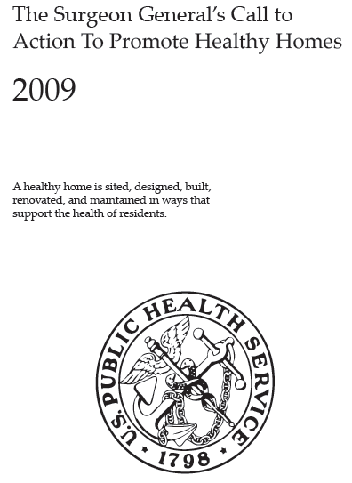
Surgeon General’s Call to Action

Slide 12
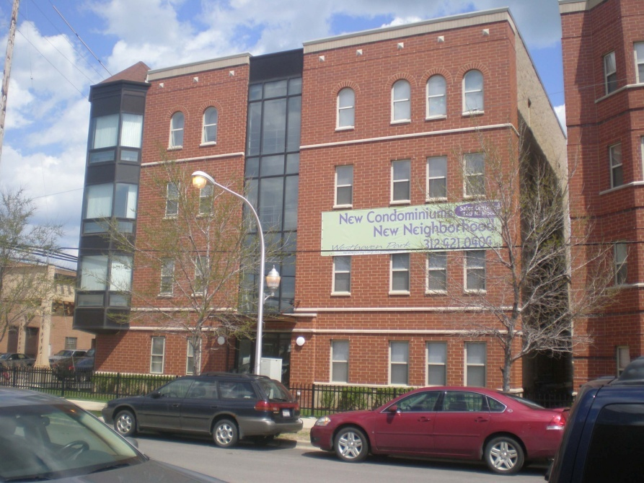
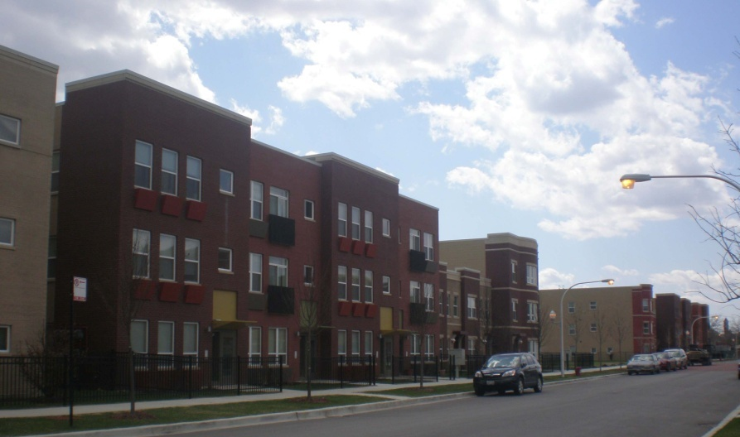
Moving Into Green Healthy Housing
J Public Health Manag Pract. 2014 Jan 7
David E. Jacobs, PhD, CIH^{a,b} Emily Ahonen, PhDª Sherry L. Dixon, PhD^{b} Samuel Dorevitch, MDª Jill Breysse, MHS, CIH^{b} Janet Smith, PhD,ª Anne Evens, PhD,^{a,c} Doborah Dobrez, PhDª Marjie Isaacson, PhD^{c} Colin Murphy, MSª Lorraine Conroy, PhD,ª Peter Levavi^{d}
University of Illinois at Chicago
Center for Neighborhood Technology
Brinshore Michaels Development National Center for Healthy Housing
Notes:
DO WE HAVE ANY PICTURES OF THE THREE CHICAGO PROPERTIES? I emailed them to Amanda, who will insert them into the presentation.
We call this study (MIGHHTY) NO I AM NOT CALLING IT MIGHHTY ANYMORE

Slide 13
Methods
Compared:
  Health status of public housing residents before and after a move from old poor-quality public housing into new green healthy housing
  These residents to a control group that did not move
Data Sources
Self-reported health by interview
Building visual assessments
24-hour air samples
Medicaid records
325 housing units in 3 Chicago housing developments
803 individuals
203,232 diagnoses
Air quality in 45 non-smoking apartments

Slide 14
General Health
Notes:
For comparison between current study group and control group, p=0.078 for adults and p=0.017 for kids
For comparison between current study group and previous study group homes, p=0.184 for adults and p<0.001 for kids.

Slide 15
Mental Health
Notes:
First, this figure is for adults (measures of study group child behavior and mental health were not significantly different from control group kids)
Second, a higher number is better for this figure (e.g., 5 means they experience sadness none of the time).
Comparing current study group adults with current control group adults:
Sadness p<0.001; restlessness p<0.001; nervousness p<0.001; hopelessness P=0.031; everything effort p=0.007
Comparing current home study group adults with previous home study group adults:
Sadness p<0.001; restlessness p<0.001; nervousness p<0.001; hopelessness P=0.001; everything effort p=0.026

Slide 16
Asthma
Notes:
In this figure, higher scores are bad.

Slide 17
Statistically Significant Physical Health Improvements
General Health
Asthma (measured by lost school/work days, disturbed sleep and symptoms)
Hay fever
Headaches
Sinusitis
Angina
Respiratory allergy

Slide 18
Breathe Easy Home Health Improvements in Asthma
Health Outcome | Change
Symptom-free days/2 weeks | 4.8 fewer days/2 weeks (p=0.004)
Urgent Clinical Care Trips (% reduction) | 41.2% (p=0.002)
Asthma Triggers in House Dust | 2.0 before/0.03 after
Caretaker Quality of Life Score | 4.9 before/5.8 after

Slide 19


Slide 20

2014

Slide 21
Conclusions
Chicagoland’s National Ranking in Healthy Housing Is In the Bottom Half and Getting Worse
Housing Is Essential in Supporting Good Health
Our Two Biggest Sectors in Crisis Are Housing and Health; Both Are Linked and Both Must Be Fixed
It Makes No Sense To Treat Children in the Hospital and Then Release Them to the Home That Made Them Sick in the First Place
Get the Data & Resources, Make the Case and Take Smart Action
Everyone Should Live in a Healthy Home

